Slide 1
WEB DEVELOPMENT
Presented by : Sweta Koley(05)
Somdutta Sengupta(10)
Sneha Pradhan(12)
Sharmi Adhikary(14)
Ankita Paul(33)
Krishna Kumar(35)

Slide 2
What is Web Development ?
Web development is simply how websites are built, implemented, and displayed on the internet. It pertains to the work behind the scenes that creates a functional website that performs a set of particular, defined functions. This includes various aspects of network security, web content development, web designing, web publishing, database management and more.
The Role Of Web Developers
Web developers are programmers who specialize in the development of applications relating to the World Wide Web or distributed network applications. These network applications typically run protocols like HTTP from a Web server to a client browser using associated programming languages like JavaScript, C#, Ruby and PHP—to name a few.
In simple words, web developers are programmers who use programming tools and write codes to “tell” a website what to do or how to function. They are like the directors and scriptwriters behind every movie.

Slide 3
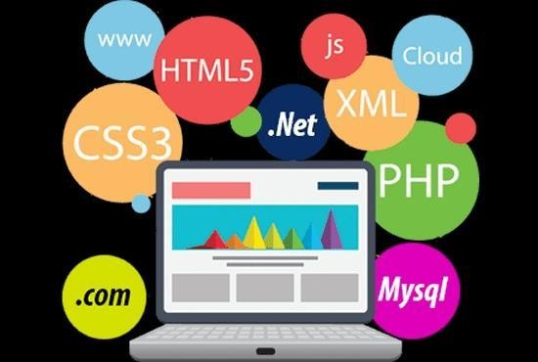
Primary technology for the web
BROWSERS
Browsers are the interpreters of the web. They request information and then when
they receive it, they show us on the page in a format we can see and understand.
Google Chrome – Currently, the most popular browser brought to you by Google
Safari – Apple’s web browse
Firefox – Open-source browser supported by the Mozilla Foundation
Internet Explorer – Microsoft’s browser. You will most often hear web developers
complain about this one.
2. HTML
HTML is a markup language. It provides the structure of a website so that web browsers know what to show.

Slide 4
3. CSS
CSS is a Cascading Style Sheet. CSS let’s web designers change colors, fonts, animations, and transitions on the web. They make the web look good.
4. Programming Languages
Programming languages are ways to communicate to computers and tell them what to do. There are many different programming languages just like there are many different lingual languages (English, Spanish, French, Chinese, etc). One is not better than the other. Developers typically are just proficient at a couple so they promote those more than others. Below are just some of the languages and links to their homepages
Javascript – used by all web browsers, Meteor, and lots of other frameworks
Python –used by the Django framework and used in a lot of mathematical calculations
5. Libraries
Libraries are groupings of code snippets to enable a large amount of functionality without having to write it all by yourself. Libraries typically also go through the trouble to make sure the code is efficient and works well across browsers and devices (not always the case, but typically they do).
jQuery
Underscore

Slide 5
6.Databases
Databases are where all your data is stored. It’s like a bunch of filing cabinets with folders filled with files. Databases come mainly in two flavors: SQL and NoSQL. SQL provides more structure which helps with making sure all the data is correct and validated. NoSQL provides a lot of flexibility for building and maintaining applications.
MySQL – is another popular open-sourced SQL database. MySQL is used in Wordpress websites.
Oracle – is an enterprise SQL database.
SQL Server – is an SQL server manager created by Microsoft.
7. Server (or Server-side)
A server is where the application code is typically stored. Requests are made to the server from clients, and the server will gather the appropriate information and respond to those requests.
8. Front-end
The front-end is comprised of HTML, CSS, and Javascript. This is how and where the website is shown to users.
9. Back-end
The back-end is comprised of your server and database. It’s the place where functions, methods, and data manipulation happens that you don’t want the clients to see.

Slide 6
Effective Web Design for Higher Education Institutions
A website is the face of an institution.It is the first impression and, hopefully, a key reason why potential students choose a college or university. It is also a way to keep students, staff, and faculty updated on critical and ever-changing information.
The website we made is a higher educational institute or a university website . We named our university as ‘Nalanda University’ .

Slide 7
The frontends we used for our website are :
CSS
HTML
Jscript
Bootstrap
Googlefont
Fontawesome icon
The backends used for our website are :
Django framework
Postgresql database
Pgadmin4

Slide 8
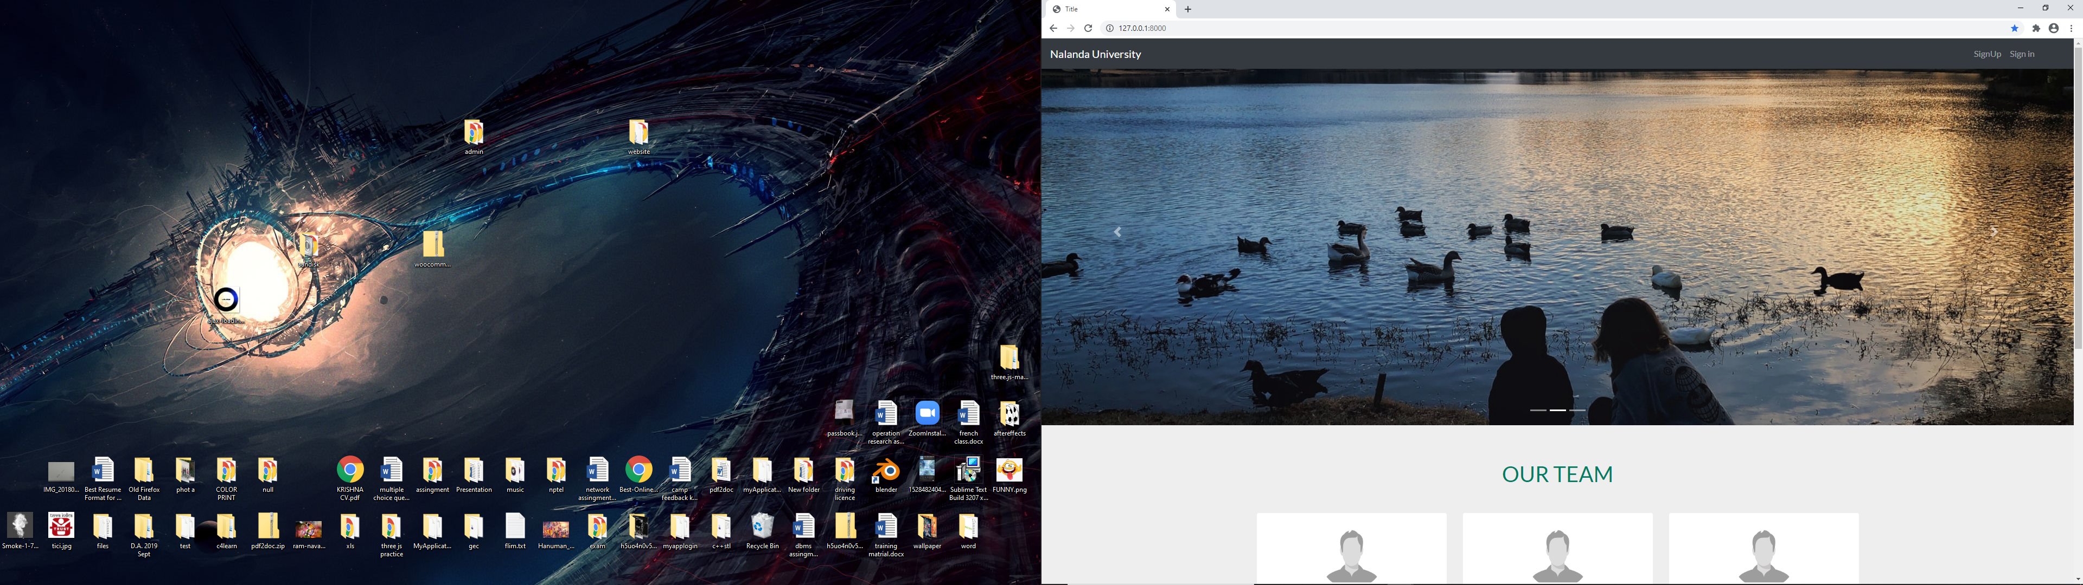
Homepage Of Our Website

Slide 9
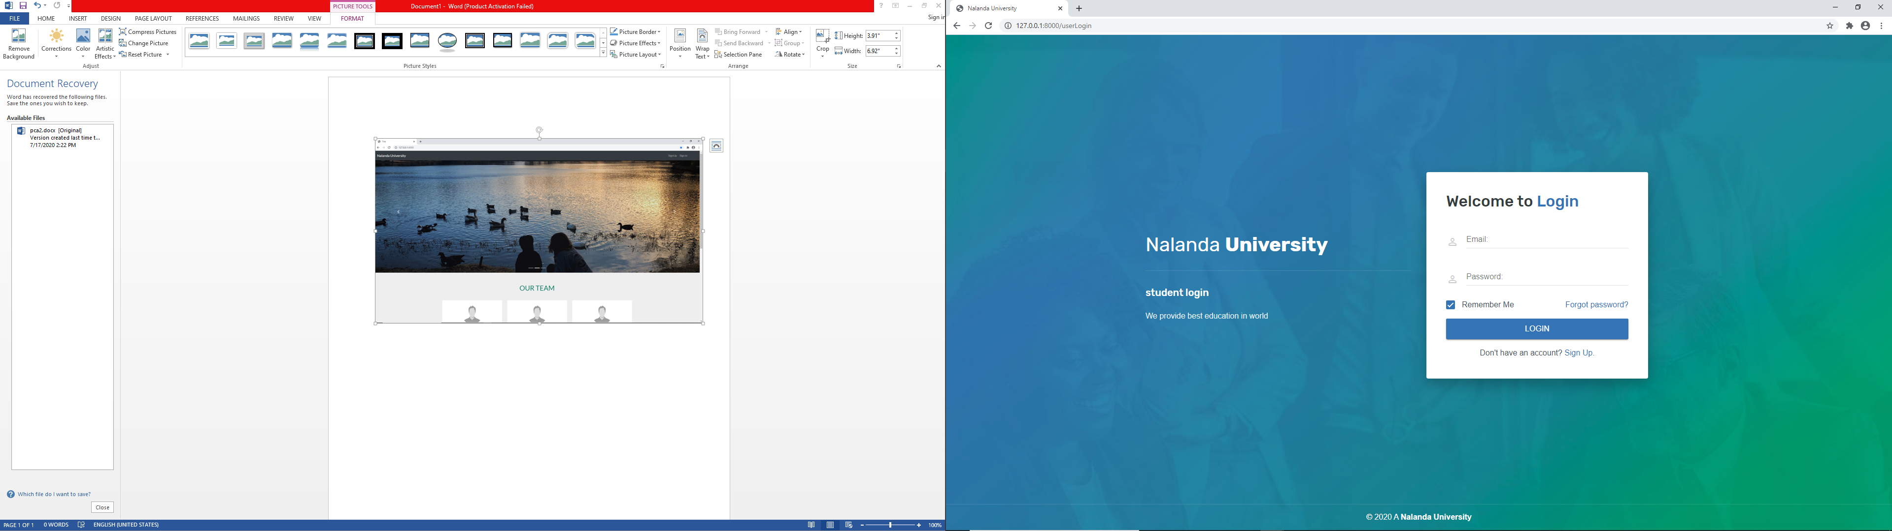
Log in page
Our University webpage consists of HOD, staff and student’s portals. To access a account one has to log in with his/her respective mail id and password.

Slide 10
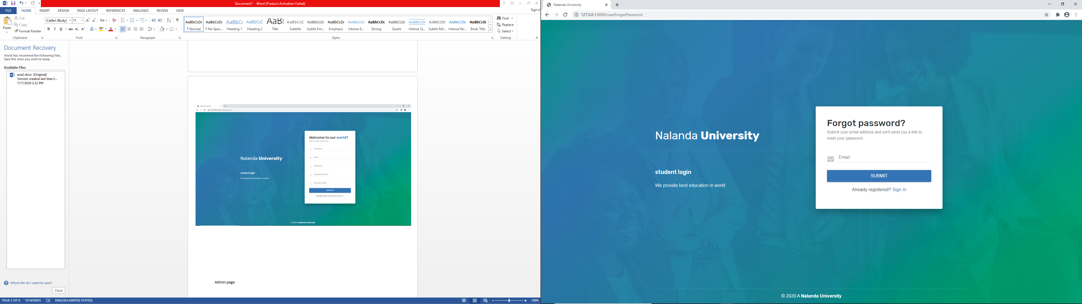
If anyone forgets his/her password he/she can easily reset it.

Slide 11
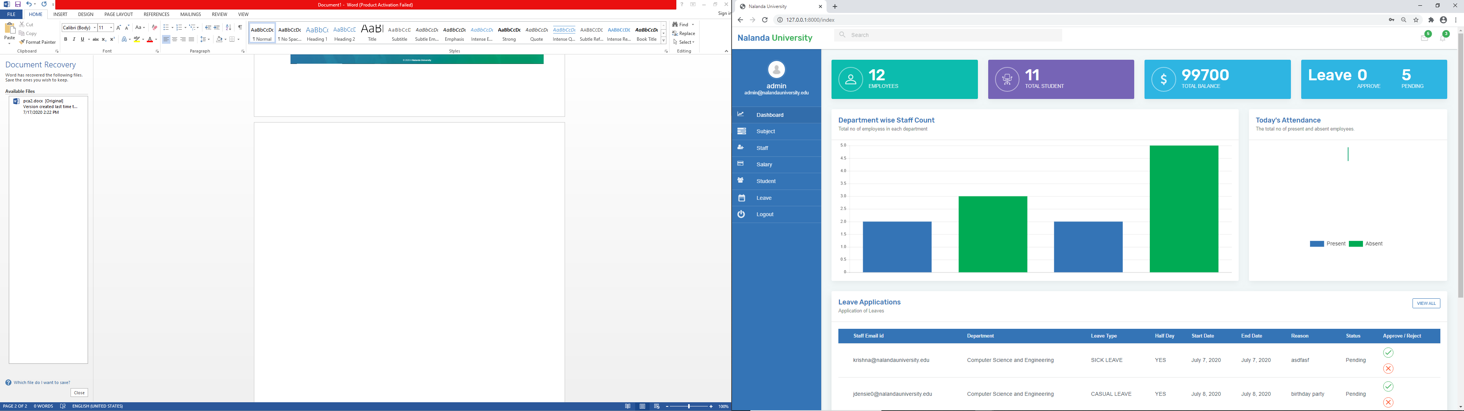
HOD’s page

Slide 12
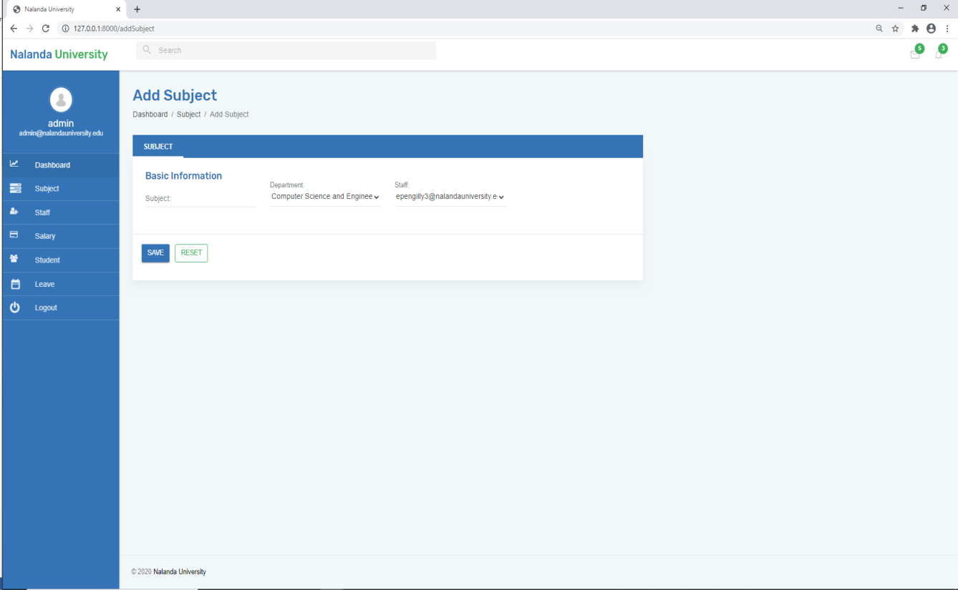
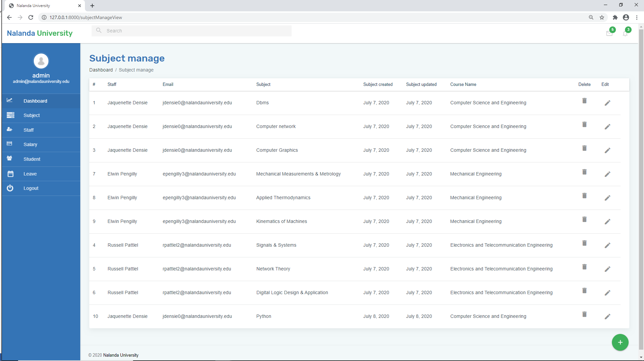
The HOD can count and update everyday’s attendance, update student’s marks , add, remove and update subjects with respective teacher’s job profile and much more

Slide 13
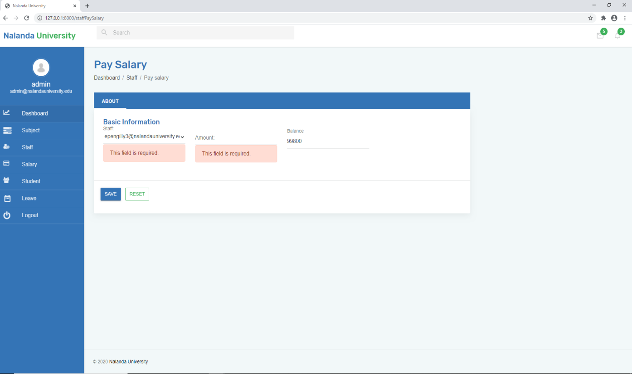
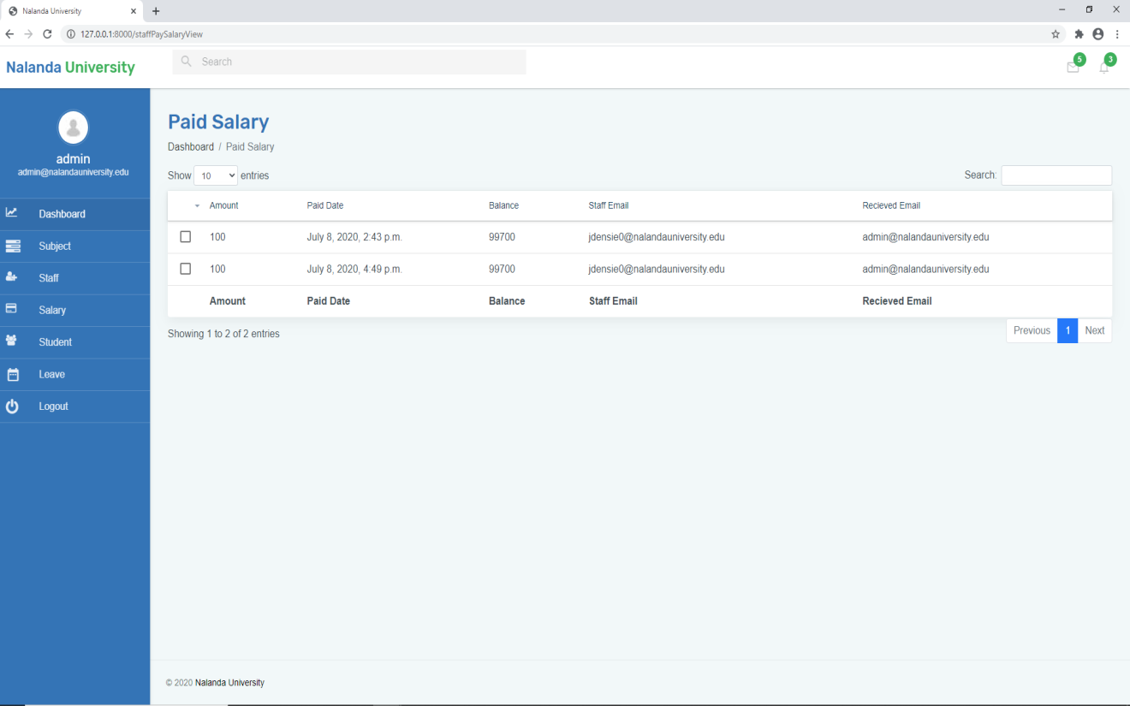
The HOD can even pay salary of teachers through this college website

Slide 14
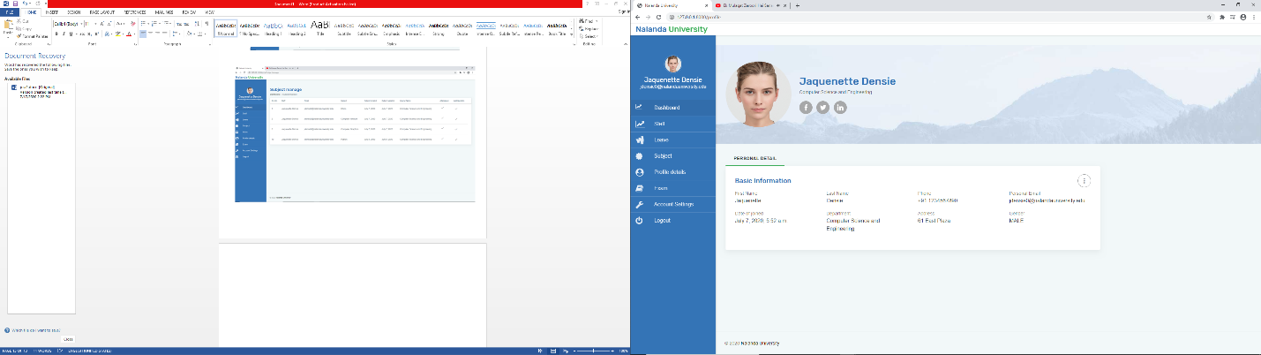
Staff’s page
A staff or a teacher can count and update student’s marks, count their attendance and update it, apply for leave, check their salary, update their subjects, update his/her detsild etc.

Slide 15
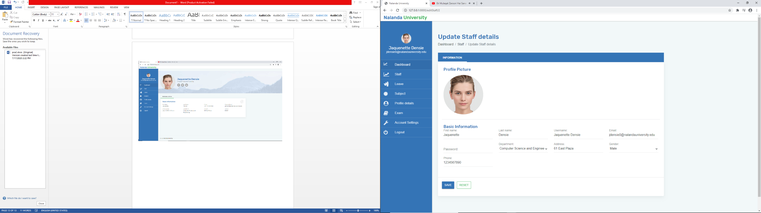
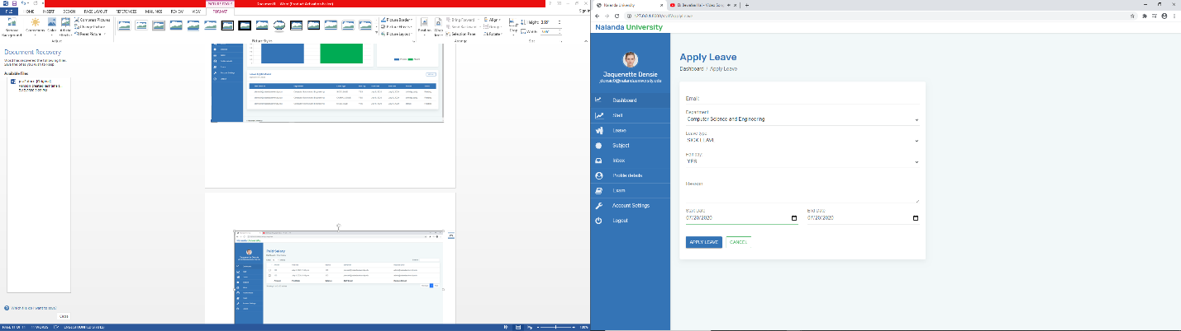

Slide 16
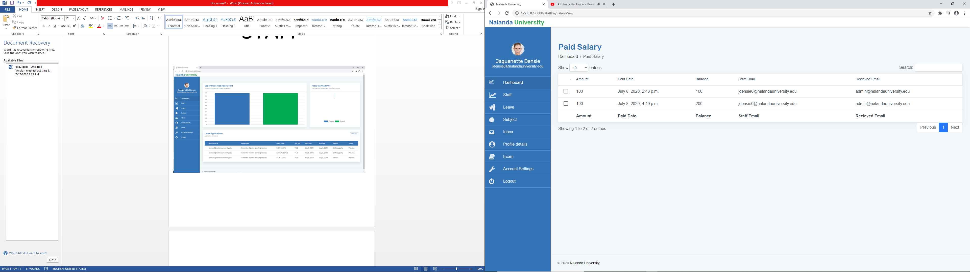

Slide 17
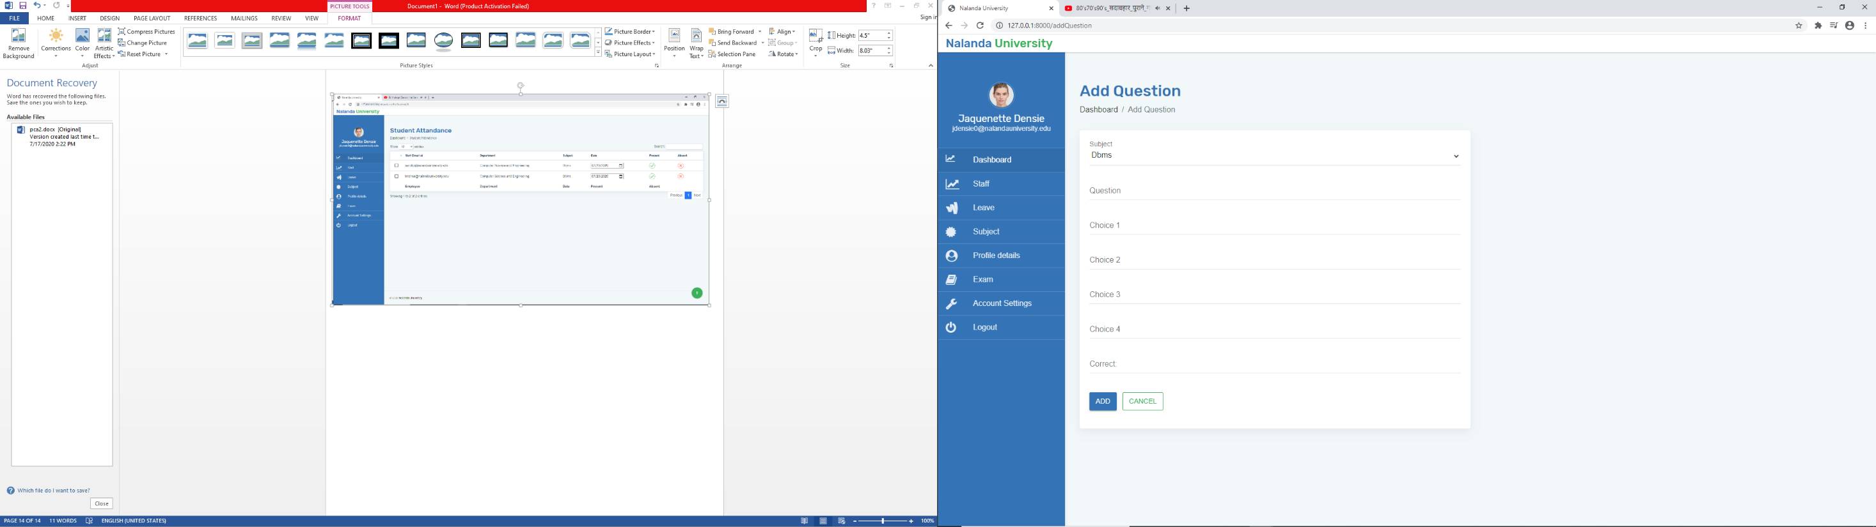
The teachers can set up question papers through the help of this website

Slide 18
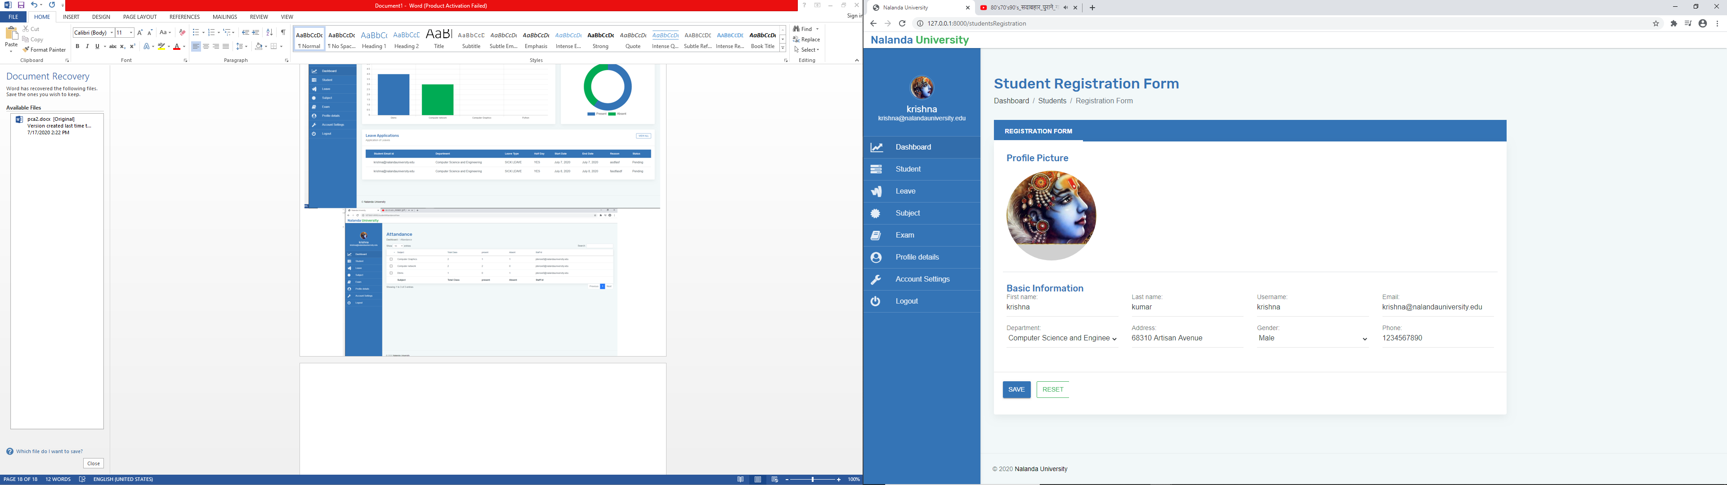
Student’s page
A student can fill up his/her registration form, give tests, see his/her paid/unpaid college fee details, apply for leave or even see his/her attendance

Slide 19
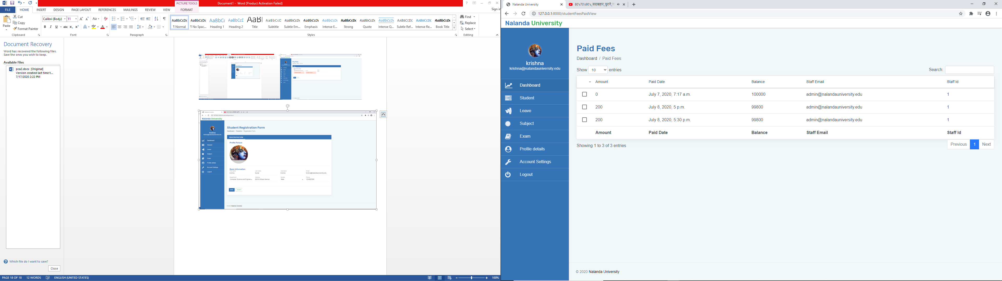

Slide 20
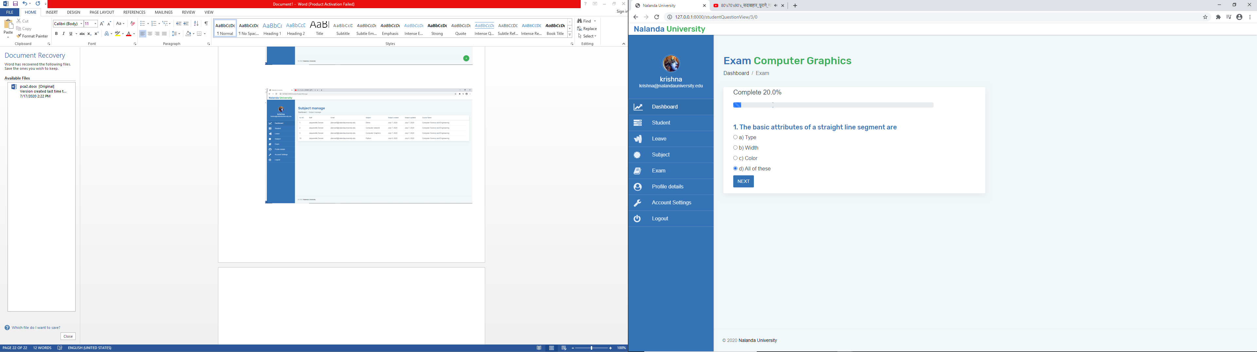

Slide 21
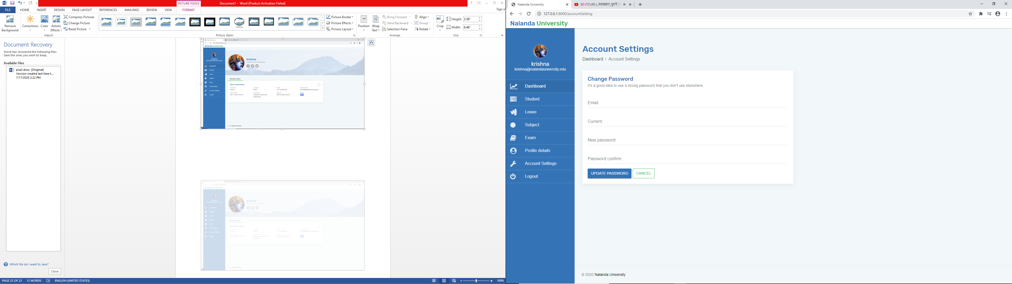
a student can update or change his account details

Slide 22
THANK YOU

